Slide 1
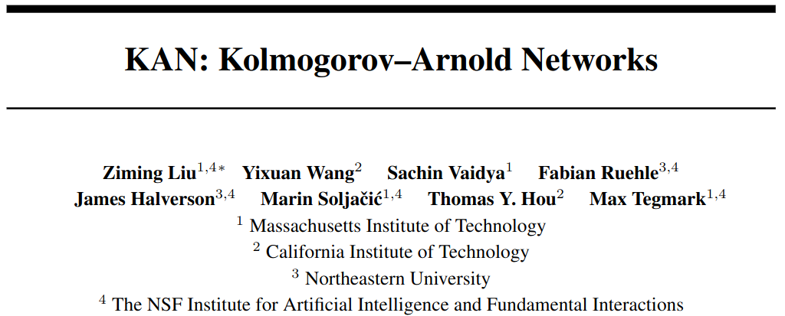
May 2024

Slide 2
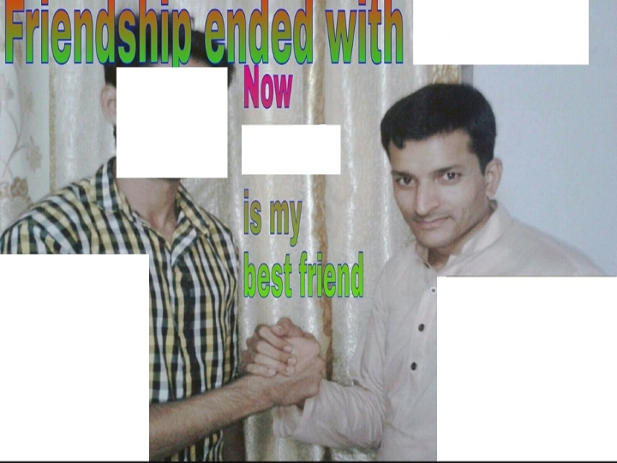
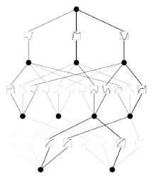
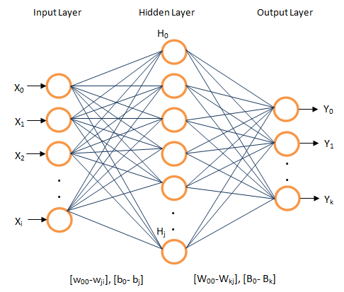
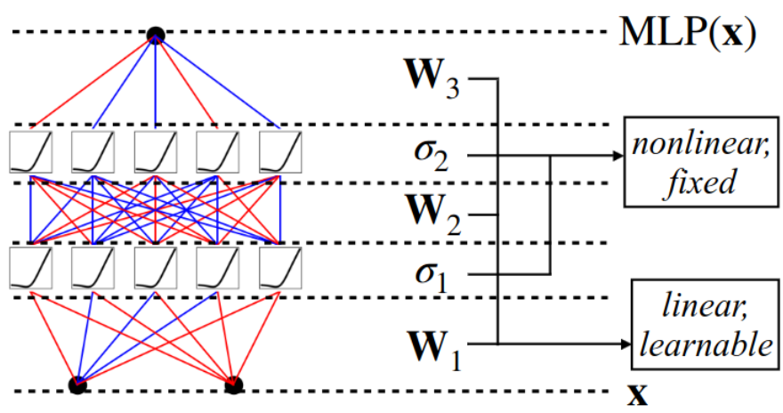
MLPs
KANs

Slide 3
Section 1: Motivation

Slide 4
Motivation
Use Kolmogorov-Arnold representation theorem instead of universal approximation theorem
More interpretable than MLPs
Can even do symbolic regression
More parameter efficient than MLPs

Slide 5
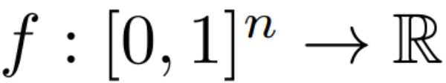
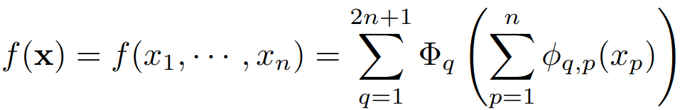
Representation theorems
MLPs: Universal Approximation Theorem
Any multivariate continuous function on a bounded domain,
can be approximated arbitrarily well by an MLP with a wide-enough
hidden layer.
KANs: Kolmogorov-Arnold Representation Theorem
Any multivariate continuous function on a bounded domain,
can be written exactly as a finite composition of continuous univariate
functions and addition. Specifically, with

Slide 6
Representation theorems
MLPs: Universal Approximation Theorem
Any multivariate continuous function on a bounded domain,
can be approximated arbitrarily well by an MLP with a wide-enough
hidden layer.
KANs: Kolmogorov-Arnold Representation Theorem
Any multivariate continuous function on a bounded domain,
can be written exactly using only addition and a finite composition of continuous univariate
functions.

Slide 7
Representation theorems
MLPs: Universal Approximation Theorem
Any multivariate continuous function on a bounded domain,
can be approximated arbitrarily well by an MLP with a wide-enough
hidden layer.
KANs: Kolmogorov-Arnold Representation Theorem
Any multivariate continuous function on a bounded domain,
can be written exactly using only addition and a finite composition of continuous univariate
functions. Specifically, with

Slide 8
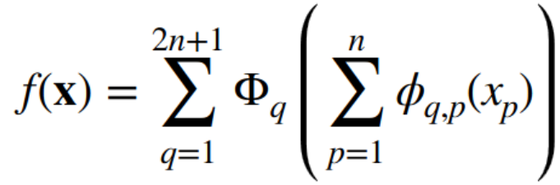
Limitations
Great! Learning any continuous multivariate function only requires us to learn a few univariate functions.
But these univariate functions, although continuous, are often awful to work with (e.g. non-smooth, fractal etc.).
So let's try: 1) stacking 'layers' of the above form;

Slide 9
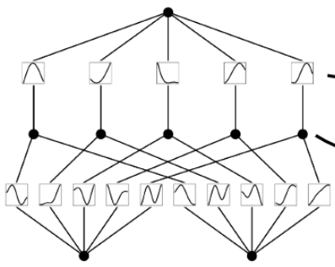

KAN Diagrams

Slide 10
Limitations
Great! Learning any continuous multivariate function only requires us to learn a few univariate functions.
But these univariate functions, although continuous, are often awful to work with (e.g. non-smooth, fractal etc.).
So let's try: 1) stacking 'layers' of the above form; and 2) ignoring the n, 2n+1 requirement for the number of 'nodes' per layer

Slide 11
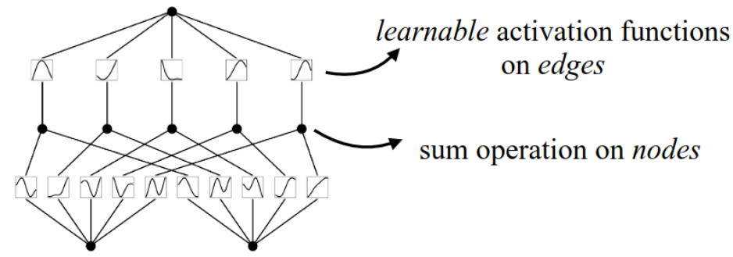
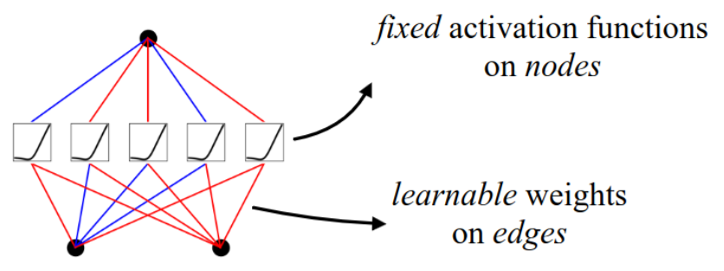
KAN Diagrams vs. MLP Diagrams
KAN
[2,5,1]
MLP
KANs are like MLPs but:
with learnable activation functions on each weight
with nodes only performing addition (no ‘global’ activation functions e.g. ReLU)

Slide 12
Section 2: Defining a KAN

Slide 13




Defining a KAN layer
A KAN layer with -dimensional inputs and -dimensional outputs can be defined as a matrix of 1D functions
where each function has trainable parameters (we’ll use splines).
Note that Kolmogorov-Arnold representation comes corresponds to two layers:
An inner layer with
And an outer layer with

Slide 14
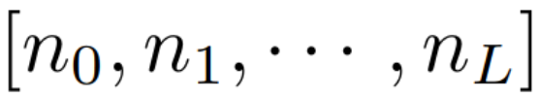
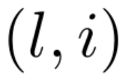
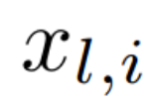
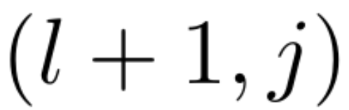
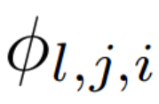
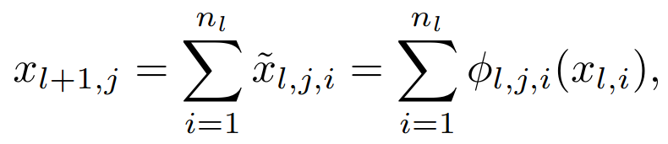
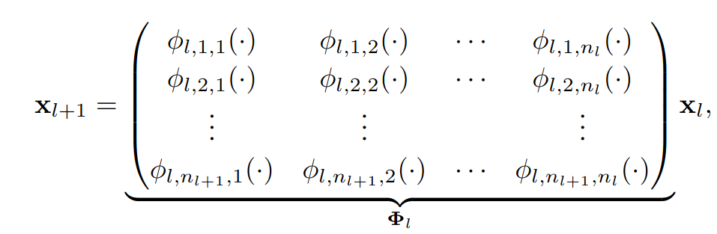
Composing KAN layers
Given the shape of a KAN (as an integer array), , write the activation in the -neuron as , and the activation function joining and as .
Then the activation at is
In matrix form:
Finally,

Slide 15
Composing KAN layers
Given the shape of a KAN (as an integer array), , write the activation in the -neuron as , and the activation function joining and as .
Then the activation at is
In matrix form:
Finally,

Slide 16
Composing KAN layers
Given the shape of a KAN (as an integer array), , write the activation in the -neuron as , and the activation function joining and as .
Then the activation at is
In matrix form:
Finally,

Slide 17
Composing KAN layers
Given the shape of a KAN (as an integer array), , write the activation in the -neuron as , and the activation function joining and as .
Then the activation at is
In matrix form:
Finally,

Slide 18
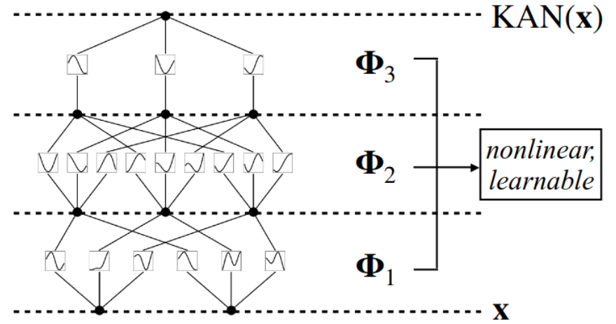
KAN vs MLP (deep)

Slide 19
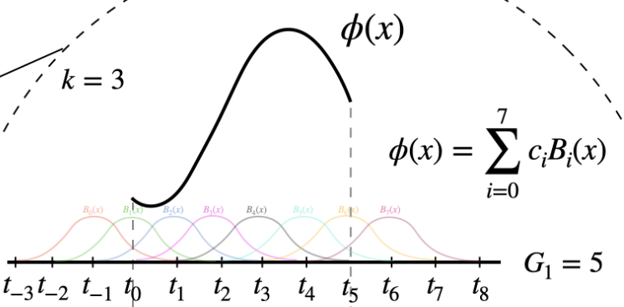
What type of functions are we learning?
Splines!
A spline function of order k is a piecewise polynomial function of degree k-1.
To simplify things, we’ll learn coefficients for B-splines of order k, which:
form a basis for all splines of order k
can be found deterministically (though not all that cheaply) given k and a grid of size G over which to define our function’s ‘pieces’

Slide 20
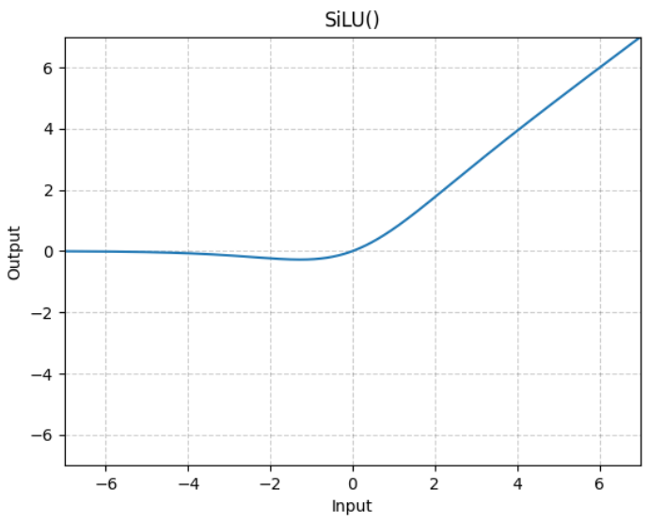




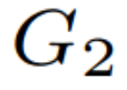
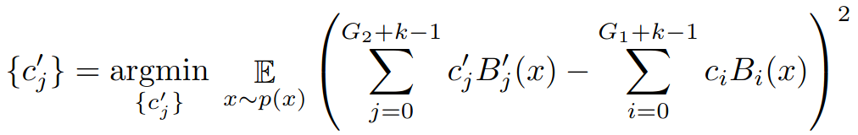
Implementation details
Splines initialised ( ) with a small grid, 3, but every 100 or so iterations, we’ll make the grid finer, say, = 5 , and choose new coefficients via least squares on the outputs of each spline:

Slide 21

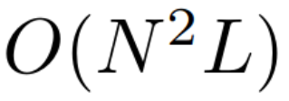


KANs are parameter efficient!
A KAN with:
Depth L;
Constant width N; using
Splines of order k, defined on grids of size G
Parameters:
(c.f. MLPs: )
But using theoretical scaling exponents for test RMSE loss:
KANs are predicted (and empirically appear) to have , i.e. performance scales very well with parameter count.

Slide 22
KANs are parameter efficient!
A KAN with:
Depth L;
Constant width N; using
Splines of order k, defined on grids of size G
Parameters:
(c.f. MLPs: )
But using theoretical scaling exponents for test RMSE loss:
KANs are predicted (and empirically appear) to have , i.e. performance scales very well with parameter count.

Slide 23
KANs are parameter efficient!
A KAN with:
Depth L;
Constant width N; using
Splines of order k, defined on grids of size G
Parameters:
(cf. MLPs: )
But using theoretical scaling exponents for test RMSE loss:
KANs are predicted (and empirically appear) to have , i.e. performance scales very well with parameter count.

Slide 24
KANs are parameter efficient!
A KAN with:
Depth L;
Constant width N; using
Splines of order k, defined on grids of size G
Parameters:
(cf. MLPs: )
But KANs seem to use their parameters more efficiently than MLPs
Theoretical scaling exponents for test RMSE loss:
KANs are predicted (and empirically appear) to have i.e. performance scales very well with parameter count.

Slide 25
KANs are parameter efficient!
A KAN with:
Depth L;
Constant width N; using
Splines of order k, defined on grids of size G
Parameters:
(cf. MLPs: )
But KANs seem to use their parameters more efficiently than MLPs
Theoretical scaling exponents for test RMSE loss:
KANs are predicted (and empirically appear) to have i.e. performance scales very well with parameter count.

Slide 26
KANs are parameter efficient!
A KAN with:
Depth L;
Constant width N; using
Splines of order k, defined on grids of size G
Parameters:
(cf. MLPs: )
But KANs seem to use their parameters more efficiently than MLPs
Theoretical scaling exponents for test RMSE loss:
KANs are predicted (and empirically appear) to have i.e. performance scales very well with parameter count.

Slide 27

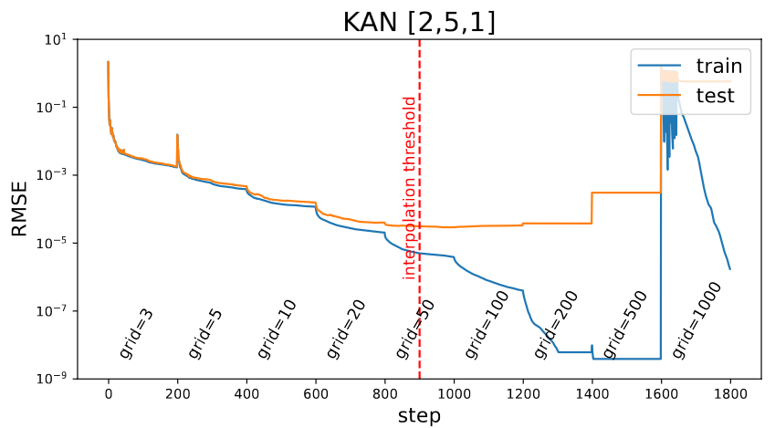
Toy Problem:

Slide 28
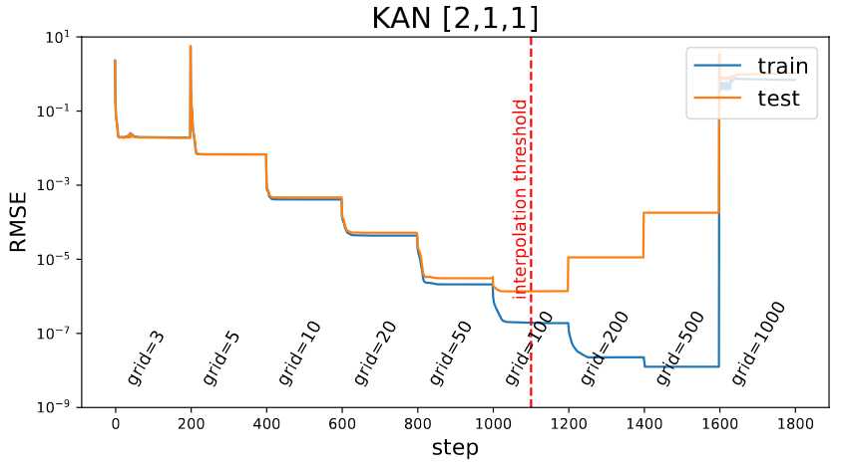
Toy Problem:
Smaller KANs may generalize better.
How can we simplify large KANs semi- or fully-automatically?

Slide 29
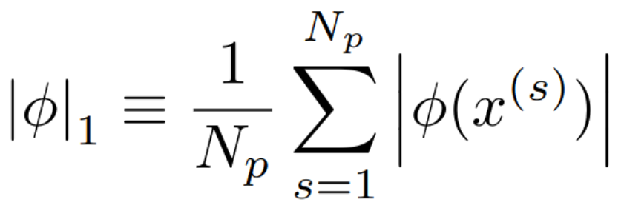
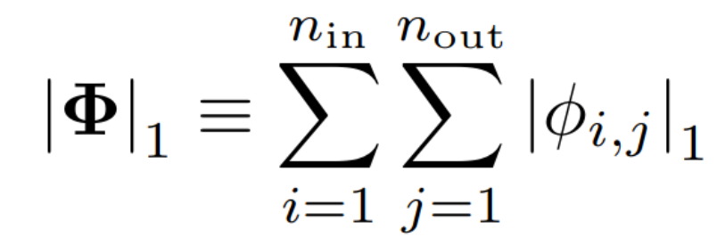
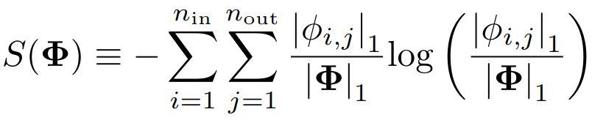
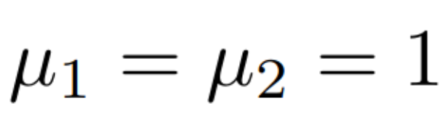
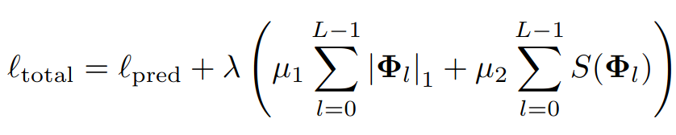
Re: Smaller KANs may generalise better
Essentially we want a notion of regularisation in KANs:
L1 norms:
Entropy:
Regularised KAN loss (usually )

Slide 30

Re: Smaller KANs may generalise better
Essentially we want a notion of regularisation in KANs:
L1 norms (average activation over inputs)
Entropy:
Regularised KAN loss (usually )

Slide 31
Re: Smaller KANs may generalise better
Essentially we want a notion of regularisation in KANs:
L1 norms (average activation over inputs) :
Entropy:
Regularised KAN loss (usually )

Slide 32
Re: Smaller KANs may generalise better
Essentially we want a notion of regularisation in KANs:
L1 norms (average activation over inputs) :
Entropy:
Regularised KAN loss (usually )

Slide 33
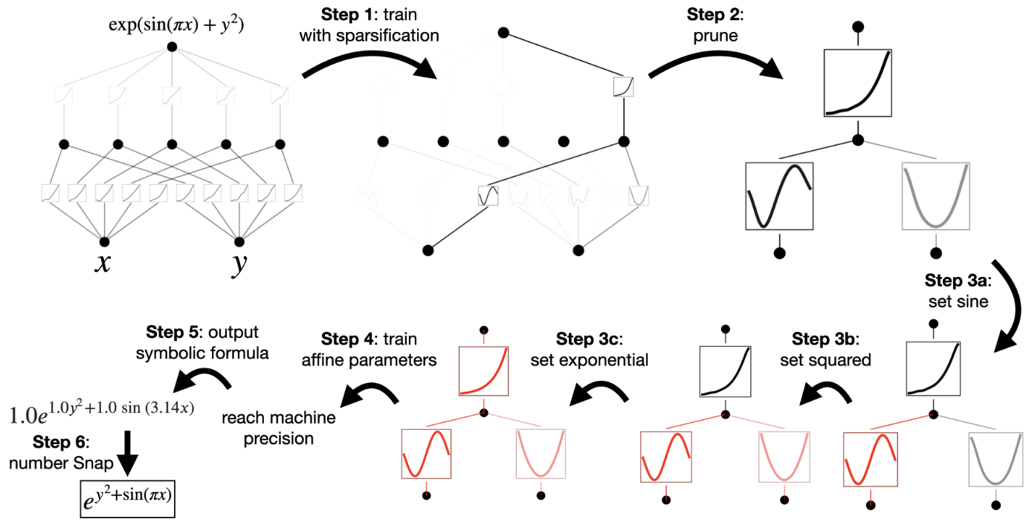
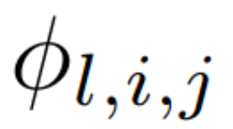
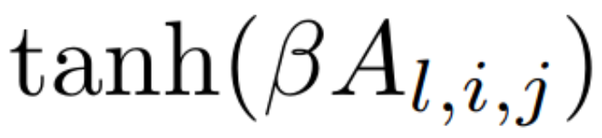
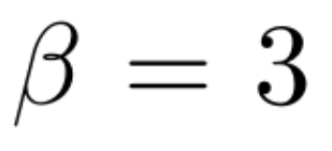
Pruning KANs
Set transparency of each activation proportional to where

Slide 34

Pruning KANs
Define incoming and outgoing score of neuron i in layer l:
Remove any neurons whose incoming or outgoing score is lower than some threshold, e.g.

Slide 35
Symbolic Regression with KANs
If you recognise the shape of an activation function, set it explicitly (rather than just a spline approximation)
(Can be detected automatically…sometimes)

Slide 36
Symbolic Regression with KANs

Slide 37
Symbolic Regression with KANs

Slide 38
Symbolic Regression with KANs

Slide 39
Symbolic Regression with KANs

Slide 40
Symbolic Regression with KANs

Slide 41
Symbolic Regression with KANs
Symbolic regression (SR) without having to work directly in symbol-space.

Slide 42
Section 3: KANs are Accurate

Slide 43
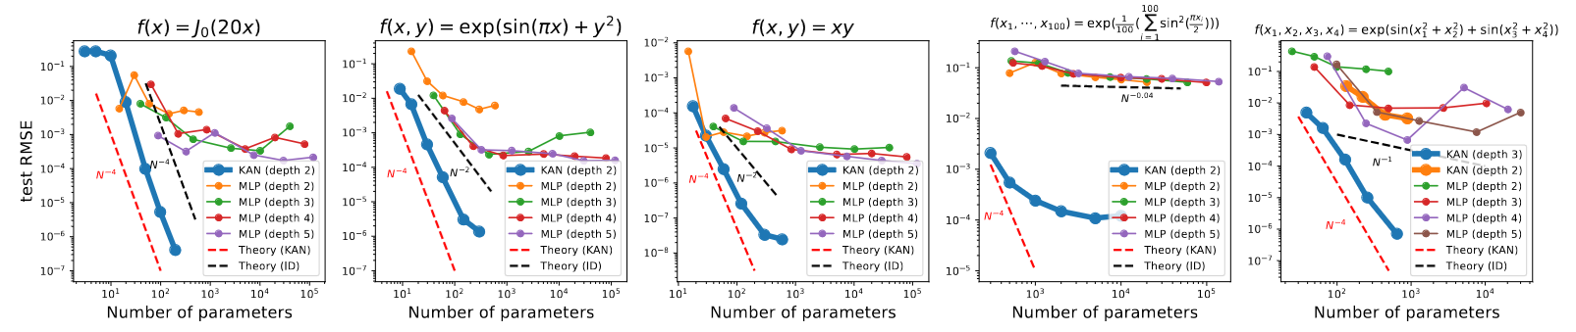
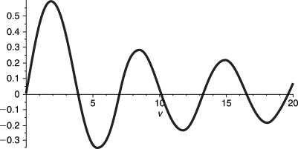

Using KANs with the expected ‘optimal’ shapes
(knowing the function beforehand)
1D Bessel function
[1,1] KAN (i.e. a spline)
2D function with two ‘layers’
[2,1,1] KAN
2D function, can use
[2,5,1] KAN (i.e. a spline)
100D function
[100,1,1] KAN
4D function
[4,4,2,1] KAN

Slide 44
Using KANs with the expected ‘optimal’ shapes
(knowing the function beforehand)
1D Bessel function
[1,1] KAN (i.e. a spline)
2D function with two ‘layers’
[2,1,1] KAN
2D function, can use
[2,5,1] KAN (i.e. a spline)
100D function
[100,1,1] KAN
4D function
[4,4,2,1] KAN

Slide 45
Using KANs with the expected ‘optimal’ shapes
(knowing the function beforehand)
1D Bessel function
[1,1] KAN (i.e. a spline)
2D function with two ‘layers’
[2,1,1] KAN
2D function, can use
[2,5,1] KAN
100D function
[100,1,1] KAN
4D function
[4,4,2,1] KAN

Slide 46
Using KANs with the expected ‘optimal’ shapes
(knowing the function beforehand)
1D Bessel function
[1,1] KAN (i.e. a spline)
2D function with two ‘layers’
[2,1,1] KAN
2D function, can use
[2,5,1] KAN
100D function
[100,1,1] KAN
4D function
[4,4,2,1] KAN

Slide 47
Using KANs with the expected ‘optimal’ shapes
(knowing the function beforehand)
1D Bessel function
[1,1] KAN (i.e. a spline)
2D function with two ‘layers’
[2,1,1] KAN
2D function, can use
[2,5,1] KAN
100D function
[100,1,1] KAN
4D function
[4,4,2,1] KAN

Slide 48
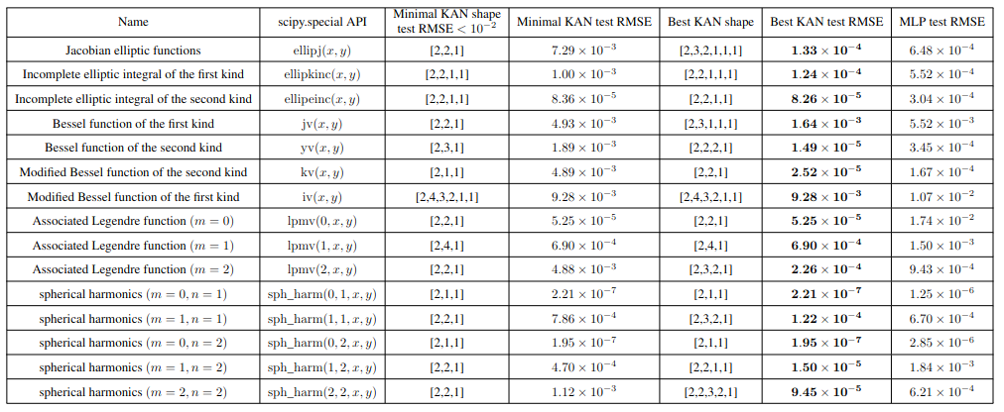
Using KANs where there are no easy expected ‘optimal’ shapes
Sweep over a bunch of KAN shapes, with 0-6 middle layers of width 5, with and without pruning

Slide 49
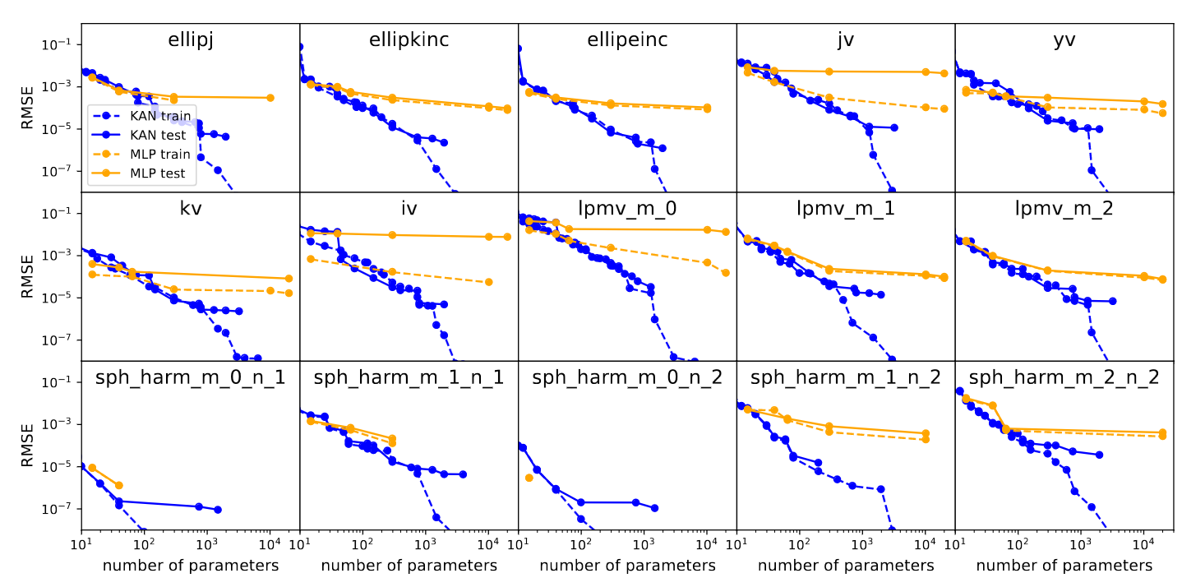
Using KANs where there are no easy expected ‘optimal’ shapes
Pareto frontiers: no other fit is both simpler and more accurate

Slide 50
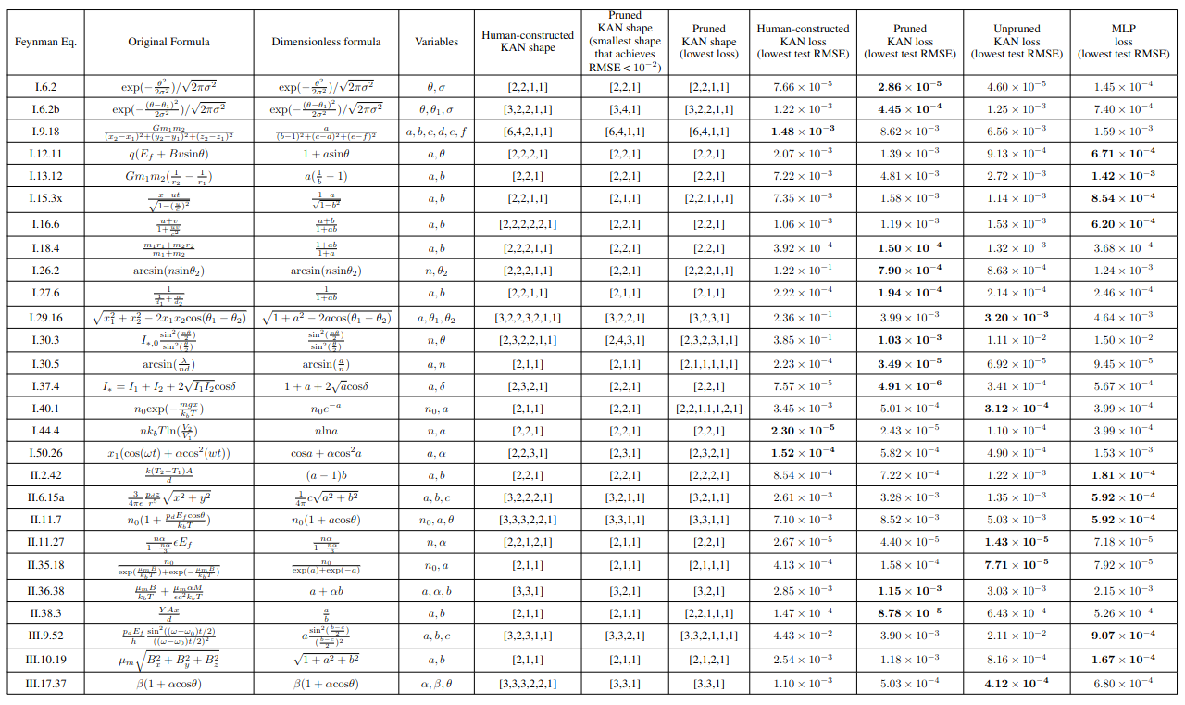
Using KANs when we think we have an idea for the optimal KAN shape
We learn that KANs can be more (parameter) efficient than we thought!

Slide 51
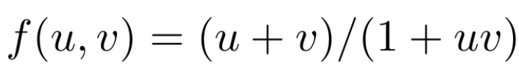

Using KANs when we think we have an idea for the optimal KAN shape
Take the relativistic velocity addition formula
Expected shape: [2,2,2,2,2,1]
2 layers for multiplication of uv (leveraging the identity )
1 layer to invert 1+uv
2 layers to multiply u+v and 1/(1+uv)
Pruned shape: [2,2,1]
Used the ‘rapidity trick’:

Slide 52
Using KANs when we think we have an idea for the optimal KAN shape
Take the relativistic velocity addition formula
Expected shape: [2,2,2,2,2,1]
2 layers for multiplication of uv (leveraging the identity )
1 layer to invert 1+uv
2 layers to multiply u+v and 1/(1+uv)
Pruned shape: [2,2,1]
Used the ‘rapidity trick’:

Slide 53
Using KANs when we think we have an idea for the optimal KAN shape
Take the relativistic velocity addition formula
Expected shape: [2,2,2,2,2,1]
2 layers for multiplication of uv (leveraging the identity )
1 layer to invert 1+uv
2 layers to multiply u+v and 1/(1+uv)
Pruned shape: [2,2,1]
Used the ‘rapidity trick’:

Slide 54
Using KANs when we think we have an idea for the optimal KAN shape
Take the relativistic velocity addition formula
Expected shape: [2,2,2,2,2,1]
2 layers for multiplication of uv (leveraging the identity )
1 layer to invert 1+uv
2 layers to multiply u+v and 1/(1+uv)
Pruned shape: [2,2,1]
Used the ‘rapidity trick’:

Slide 55
Using KANs when we think we have an idea for the optimal KAN shape
Take the relativistic velocity addition formula
Expected shape: [2,2,2,2,2,1]
2 layers for multiplication of uv (leveraging the identity )
1 layer to invert 1+uv
2 layers to multiply u+v and 1/(1+uv)
Pruned shape: [2,2,1]
Used the ‘rapidity trick’:

Slide 56
Using KANs when we think we have an idea for the optimal KAN shape
Take the relativistic velocity addition formula
Expected shape: [2,2,2,2,2,1]
2 layers for multiplication of uv (leveraging the identity )
1 layer to invert 1+uv
2 layers to multiply u+v and 1/(1+uv)
Pruned shape: [2,2,1]
Used the ‘rapidity trick’:

Slide 57
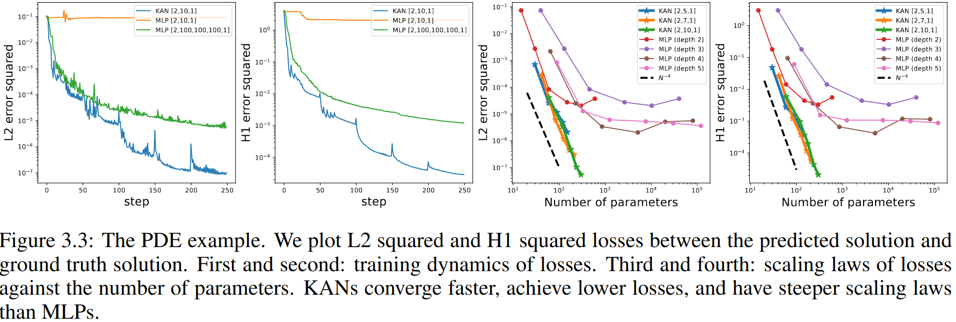
Using KANs to solve PDEs

Slide 58
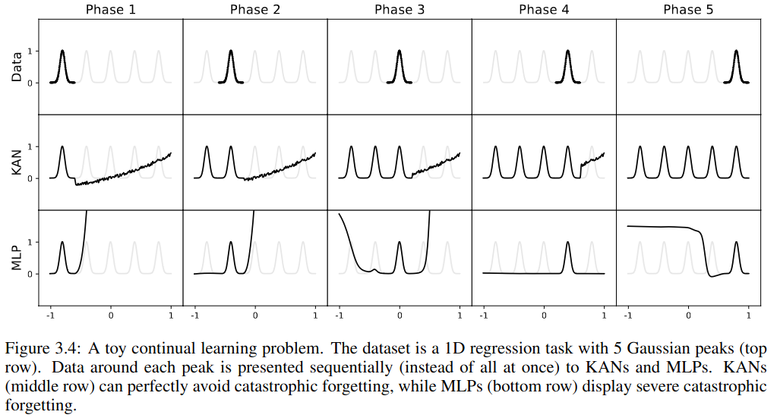
Using KANs for Continual Learning
Grids used in splines are naturally pretty robust against catastrophic forgetting

Slide 59
Section 4: KANs are Interpretable

Slide 60
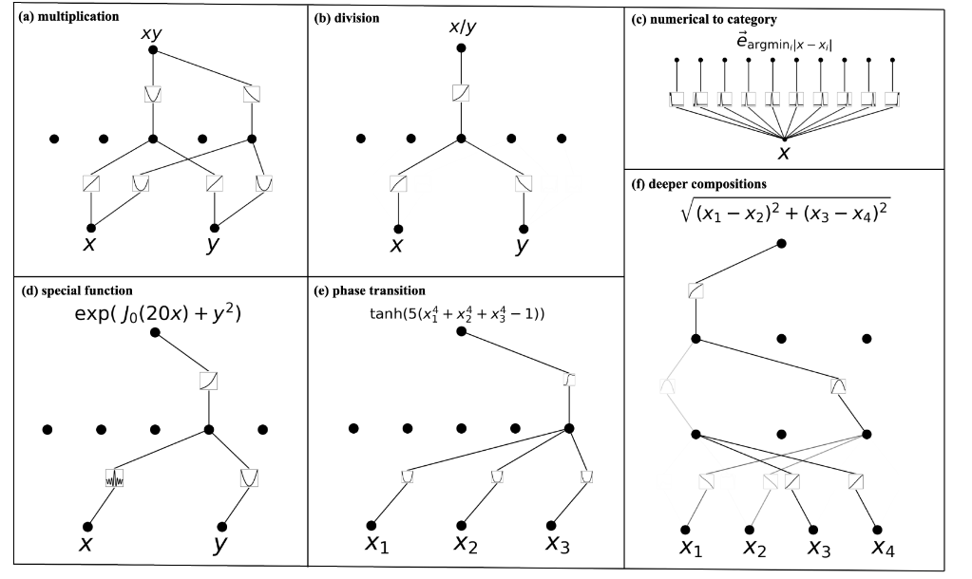

Interpreting Known Symbolic Functions
(a)
(b)
(c) learns approx. dirac deltas/spikes
(task in (c) was classifying from [0,1] by leading decimal digit.)

Slide 61


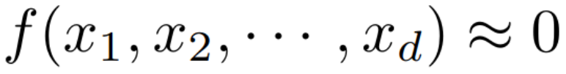
KANs for Unsupervised Learning
Unsupervised learning: given dataset of features , find a non-zero such that
Add some ‘negative’ samples to your dataset (e.g. by corrupting ‘positive’/true samples through shuffling/permutation/noise/etc.)
Fix the final layer of your KAN to be Dirac-delta-like (Gaussian with small scale) and see what structures come out when you do pruning.
Repeat KAN training with lots of different random seeds and each time you might get a different set of structures appearing
"in the future we would like to investigate a more systematic and more controlled way to discover a complete set of relations"

Slide 62
KANs for Unsupervised Learning
Unsupervised learning: given dataset of features , find a non-zero such that
Add some ‘negative’ samples to your dataset (e.g. by corrupting ‘positive’/true samples through shuffling/permutation/noise/etc.)
Fix the final layer of your KAN to be Dirac-delta-like (Gaussian with small scale) and see what structures come out when you do pruning.
Repeat KAN training with lots of different random seeds and each time you might get a different set of structures appearing
"in the future we would like to investigate a more systematic and more controlled way to discover a complete set of relations"

Slide 63
KANs for Unsupervised Learning
Unsupervised learning: given dataset of features , find a non-zero such that
Add some ‘negative’ samples to your dataset (e.g. by corrupting ‘positive’/true samples through shuffling/permutation/noise/etc.)
Fix the final layer of your KAN to be Dirac-delta-like (Gaussian with small scale) and see what structures come out when you do pruning.
Repeat KAN training with lots of different random seeds and each time you might get a different set of structures appearing
"in the future we would like to investigate a more systematic and more controlled way to discover a complete set of relations"

Slide 64
KANs for Unsupervised Learning
Unsupervised learning: given dataset of features , find a non-zero such that
Add some ‘negative’ samples to your dataset (e.g. by corrupting ‘positive’/true samples through shuffling/permutation/noise/etc.)
Fix the final layer of your KAN to be Dirac-delta-like (Gaussian with small scale) and see what structures come out when you do pruning.
Repeat KAN training with lots of different random seeds and each time you might get a different set of structures appearing
"in the future we would like to investigate a more systematic and more controlled way to discover a complete set of relations"

Slide 65
KANs for Unsupervised Learning
Unsupervised learning: given dataset of features , find a non-zero such that
Add some ‘negative’ samples to your dataset (e.g. by corrupting ‘positive’/true samples through shuffling/permutation/noise/etc.)
Fix the final layer of your KAN to be Dirac-delta-like (Gaussian with small scale) and see what structures come out when you do pruning.
Repeat KAN training with lots of different random seeds and each time you might get a different set of structures appearing
"in the future we would like to investigate a more systematic and more controlled way to discover a complete set of relations"

Slide 66
KANs for Unsupervised Learning
Unsupervised learning: given dataset of features , find a non-zero such that
Add some ‘negative’ samples to your dataset (e.g. by corrupting ‘positive’/true samples through shuffling/permutation/noise/etc.)
Fix the final layer of your KAN to be Dirac-delta-like (Gaussian with small scale) and see what structures come out when you do pruning.
Repeat KAN training with lots of different random seeds and each time you might get a different set of structures appearing
"in the future we would like to investigate a more systematic and more controlled way to discover a complete set of relations"

Slide 67



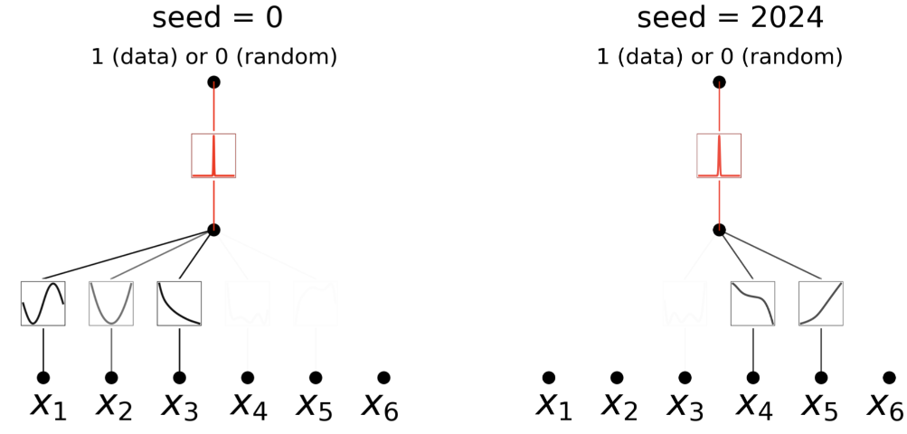
KANs for Unsupervised Learning: Toy example
6D dataset, with dependencies:
independent of other variables

Slide 68
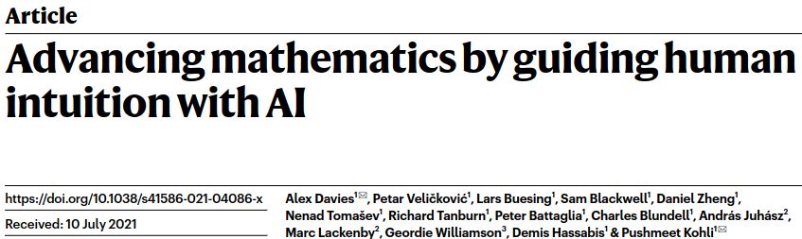




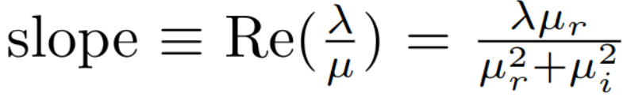
Application to Knot Theory
DeepMind paper: found link between certain variables about knots, which mathematicians refined to prove a new theorem.
Signature is mostly dependent on meridinal distance and longitudinal distance
Found a bound for where

Slide 69
Application to Knot Theory
DeepMind paper: found link between certain variables about knots, which mathematicians refined to prove a new theorem.
Signature is mostly dependent on meridinal distance and longitudinal distance
Found a bound for where

Slide 70
Application to Knot Theory
DeepMind paper: found link between certain variables about knots, which mathematicians refined to prove a new theorem.
Signature is mostly dependent on meridinal distance and longitudinal distance
Found a bound for where

Slide 71
Application to Knot Theory
DeepMind paper: found link between certain variables about knots, which mathematicians refined to prove a new theorem.
Signature is mostly dependent on meridinal distance and longitudinal distance
Found a bound for where

Slide 72
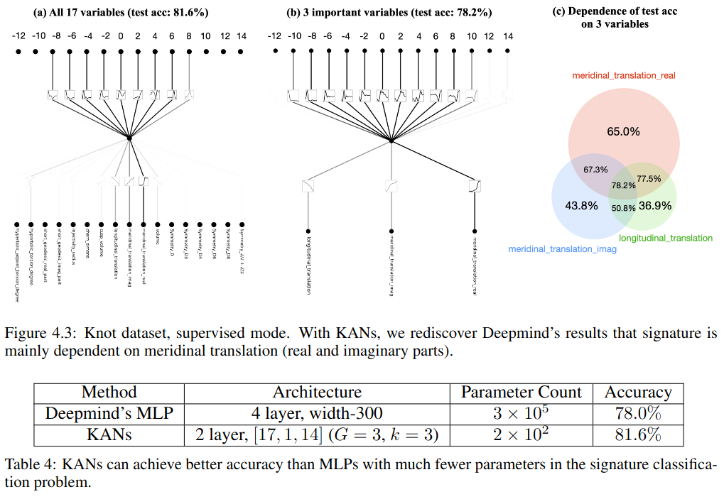
Application to Knot Theory: Supervised Learning
Given 17 input features and use knot signatures (even numbers) as output/targets for a [17,1,14] KAN

Slide 73
Application to Knot Theory: Supervised Learning
Given 17 input features and use knot signatures (even numbers) as output/targets for a [17,1,14] KAN

Slide 74
Application to Knot Theory: Supervised Learning
Given 17 input features and use knot signatures (even numbers) as output/targets for a [17,1,14] KAN

Slide 75
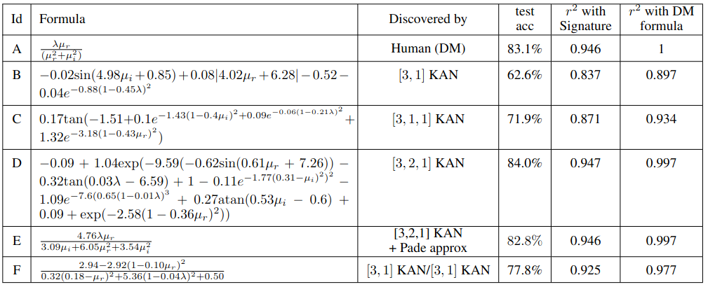
Application to Knot Theory: Supervised Learning
They even found a (potentially) interesting relationship: you can still get 77.8% test accuracy with only 2 of the variables DeepMind used

Slide 76

Application to Knot Theory: Unsupervised Learning
Take 17 input features and knot signatures together
Create negative samples by shuffling features in dataset

Slide 77
Application to Physics (that I don’t really understand)
But the KANs do well and they walk through how a researcher might use a KAN to discover a model
(the latter which might be worth walking through in this talk...)

Slide 78
Drawbacks
“KANs are usually 10x slower than MLPs, given the same number of parameters”
Batching is more complicated because of variety of activation functions
(Though you can restrict some neurons to use the same activation)
B-spline computation isn’t incredibly fast
Very small scale architectures (for now)

Slide 79
Conclusion
Accurate
Good scaling with #params (so far)
Very interpretable
Useful in other scientific fields, but not necessarily shown to be good for deep learning
Don't have to use splines:
Radial basis functions or other local kernels supposedly work well (according to a guy on reddit)
"Kansformers" - replace MLP in transformer by KANs
Working "okay" (or some other non-committal word) according to the lead author on twitter

Slide 80
Appendix

Slide 81
Parameter efficiency: External vs Internal Degrees of Freedom
External dofs (large-scale structure):
MLPs: connections between nodes
KANs: connections between nodes
Internal dofs (small-scale structure):
KANs: splines
MLPs: linear transformations (and ‘global’ activation functions)

Slide 82


KAN approximation theory
"beats the curse of dimensionality!"
This error bound doesn’t depend on input dimension, (...except for the multiplicative constant)

Slide 83


PDE Problem

